Slide 1
Coles Customer Segmentation
Impulse
Hari Hara Priya Kannan
Shamini Baby
Clarine Anslum

Slide 2


Overview
Background and Objectives
Data Exploration and Preprocessing
Clustering Analysis
Customer Segments
Project Outcomes and Summary

Slide 3
Background and Objectives
Customer Segmentation for Impulse category
Aim: To performing a customer segmentation analysis on data relating to Coles Impulse customers in order to group customers based on similar features
Objectives Breakdown:
Data extraction – understand data and identify the right fields
Research - determine an appropriate segmentation technique to apply
Data pre-processing – formatting the data to required format
Clustering – apply segmentation techniques
Profiling – identify meaningful segments within impulse

Slide 4
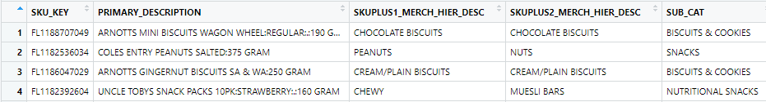
Data Exploration and Preprocessing
Impulse SKUs analysis
All the products within the impulse categories were selected from the cedwdm.stock_keeping_unit_mv table.
It was identified that the best fields to describe the products were skuplus1_hier_merch_desc, skuplus2_hier_merch_desc, skuplus3_hier_merch_desc and hence they were selected along with the sku_key.

Slide 5
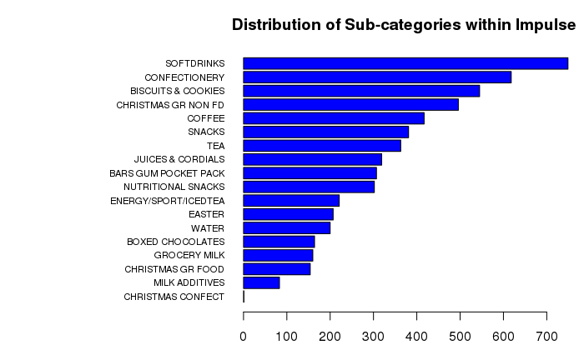
Data Exploration and Preprocessing cont.
Distribution of Sub-categories Impulse SKUS

Slide 6
Data Exploration and Preprocessing cont.
Product Level Analysis
For the product level analysis the following information was obtained product wise from the cedwdm.transaction_product_vw table for the past one year
Total sales amount in dollars
Total number of visits
Total discounts given for the product
Total number of items purchased
Number of stores where the product is sold
The products were filtered such that only products with sale amount > 0 and sold in at least 200 were selected.

Slide 7
Data Exploration and Preprocessing cont.
Product Level Analysis

Slide 8
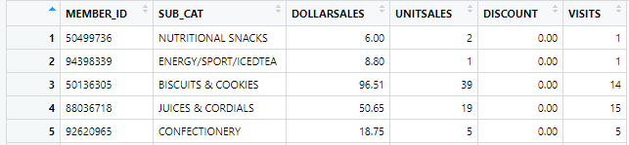
Data Exploration and Preprocessing cont.
Customer level transactions
To obtain the customer level transactions, the relevant transactions corresponding to the items were identified based on the sku_key of impulse products.

Slide 9
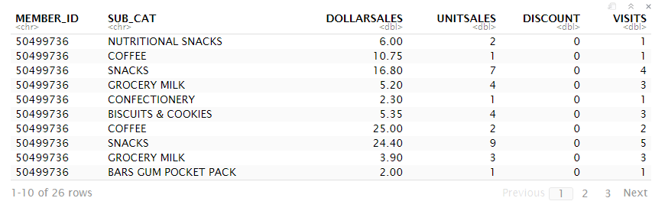
Data Exploration and Preprocessing cont.
Customer level transactions
From the table obtained, we can observe that the customer level transactions are not aggregated on an individual customer level.

Slide 10
Data Exploration and Preprocessing cont.
Customer level transactions
In order to perform the customer level segmentation, it is required to have the characteristics for each customer such as
Frequency of the customer – total times the customer visited Coles
Amount spent – overall amount by the customer in the last year
Total discount obtained – how much discount has the customer obtained overall

Slide 11
Data Exploration and Preprocessing cont.
Filtering Dataset - Overview
Identify potentially disruptive observations and filter the dataset.
Issues identified
Very high/very low sales values
Customers who are too frequent or hardly visit the store

Slide 12
Data Exploration and Preprocessing cont.
Final Dataset
After all initial wrangling, customer transactions and deli product categories data were summarised so that each customer’s deli product purchases were broken down into percentage of each customer’s total spend.
An example of the summarised table:

Slide 13
Clustering Analysis
Clustering Techniques
K-Means Clustering : - Easy to implement
- Appropriate for large datasets
- Challenging to determine value of K
Hierarchical Clustering : - Easy to implement
- Informative & easy to interpret structure
- Large computation time

Slide 14
Clustering Analysis cont.
Finding the number of clusters (K)
No clear cut way of finding K…
Commonly used approaches include the elbow and silhouette methods.
Elbow Method:
Silhouette Method:
The within-cluster sum of squared errors for each iteration is visualised.
The point at which an “elbow” appears in the plot can be taken as the ideal value of K.
The average silhouette widths (measure of between-cluster point differences) are visualised.
The point with the highest average silhouette width can be taken as K.

Slide 15
Customer Segments
Preparing Profiling Variables
Profiling involves overlaying customer information onto the generated clusters in order to identify certain trends.
Essentially a very subjective process.
Information to be used in profiling includes:
All RFM related variables
Demographic information (Age, State, etc…)
Affluence Level
Swipe Frequency
Loyalty Segment
Customer Life stage
Shopper Segment (Sweet Tooth Fanatics, Fresh Foodies, etc…)

Slide 16
Thank you!

